Slide 1
Investor Presentation
January 14, 2019

Slide 2
Forward-looking statements
Forward-Looking Statements
This presentation contains forward-looking statements that are subject to risks and uncertainties. All statements other than statements of historical fact or relating to present facts or current conditions included in this presentation are forward-looking statements. Forward-looking statements give El Pollo Loco Holdings, Inc.’s (the “Company”), current expectations and projections relating to its financial condition, results of operations, plans, objectives, future performance and business. You can identify forward-looking statements by the fact that they do not relate strictly to historical or current facts. These statements may include words such as “anticipate,” “estimate,” “expect,” “project,” “plan,” “intend,” “believe,” “may,” “should,” “can have,” “likely” and other words and terms of similar meaning in connection with any discussion of the timing or nature of future operating or financial performance or other events.
The forward-looking statements contained in this presentation are based on assumptions that the Company has made in light of its industry experience and perceptions of historical trends, current conditions, expected future developments and other factors it believes are appropriate under the circumstances. As you read and consider this presentation, you should understand that these statements are not guarantees of performance or results. They involve risks, uncertainties (many of which are beyond our control), and assumptions. Although the Company believes that these forward-looking statements are based on reasonable assumptions, you should be aware that many factors could affect its actual operating and financial performance and cause its performance to differ materially from the performance anticipated in the forward-looking statements. The Company believes these factors include, but are not limited to, those described under the sections “Forward-Looking Statements,” “Risk Factors,” and “Management’s Discussion and Analysis of Financial Condition and Results of Operations” in its prospectuses and periodic reports, including in its most recent annual report on Form 10-K as it may be updated from time to time by quarterly reports on Form 10-Q. Should one or more of these risks or uncertainties materialize, or should any of these assumptions prove incorrect, the Company’s actual operating and financial performance may vary in material respects from the performance projected in these forward-looking statements.
Any forward-looking statement made by the Company in this presentation speaks only as of the date on which it is made. Factors or events that could cause the Company’s actual operating and financial performance to differ may emerge from time to time, and it is not possible for the Company to predict all of them. The Company undertakes no obligation to publicly update any forward-looking statement, whether as a result of new information, future developments or otherwise, except as may be required by law.
Non-GAAP Financial Measures
This presentation contains certain non-GAAP financial measures. A “non-GAAP financial measure” is defined as a numerical measure of a company’s financial performance that excludes or includes amounts so as to be different than the most directly comparable measure calculated and presented in accordance with GAAP in the statements of income, balance sheets or statements of cash flow of the company. The Company has provided a reconciliation of Adjusted EBITDA, a non-GAAP financial measure, to net income in the Appendix to this presentation. Adjusted EBITDA is presented because management believes that such financial measure, when viewed with the Company’s results of operations in accordance with GAAP and the reconciliation of Adjusted EBITDA to net income (or loss), provides additional information to investors about certain material non-cash items and about unusual items that the Company does not expect to continue at the same level in the future. Adjusted EBITDA is used by investors as a supplemental measure to evaluate the overall operating performance of companies in the Company’s industry, and you should not consider it in isolation, or as a substitute for analysis of results as reported under GAAP. Our calculation of Adjusted EBITDA may not be comparable to that reported by other companies. For additional information about our non-GAAP financial measures, see our filings with the Securities and Exchange Commission.
JOBS Act
The Company is an “emerging growth company” within the meaning of the Jumpstart Our Business Startups Act. As a result, the Company is subject to reduced public company reporting requirements.

Slide 3

Our concept
what we do best
Hand-crafted,
Citrus-marinated,
Fresh-never-frozen,
Fire-grilled chicken
category we’ve created
EPL = The Grill
LA-Mex
Better for you
Fast-casual quality
QSR prices
Day-parts
Lunch
Dinner

Slide 4
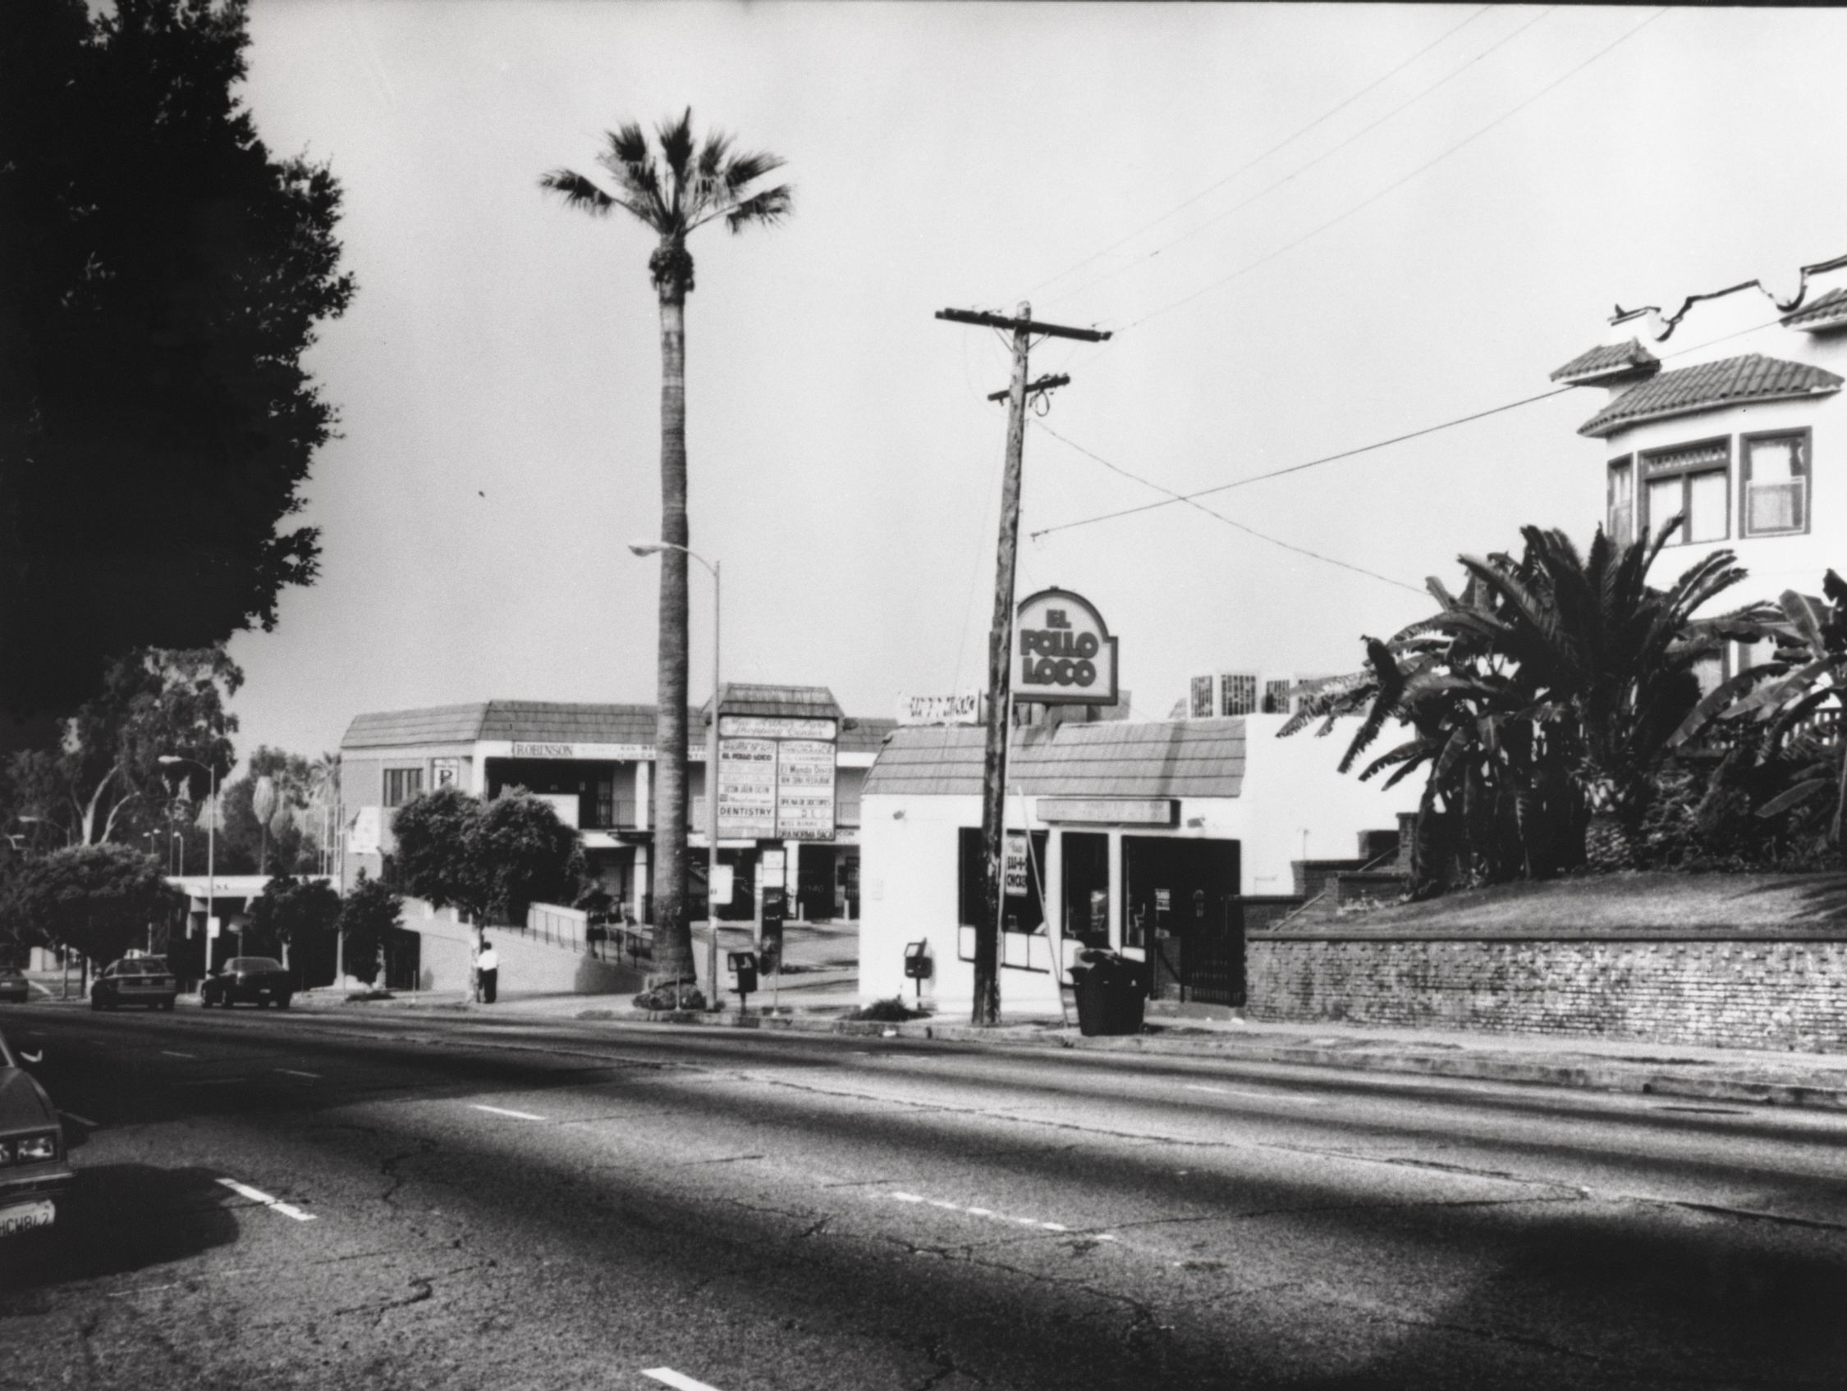
Where we started
Brand started in Sinaloa, Mexico in 1975
First restaurant opened in the united states in Los Angeles in 1980
Celebrating our 40th anniversary next year

Slide 5
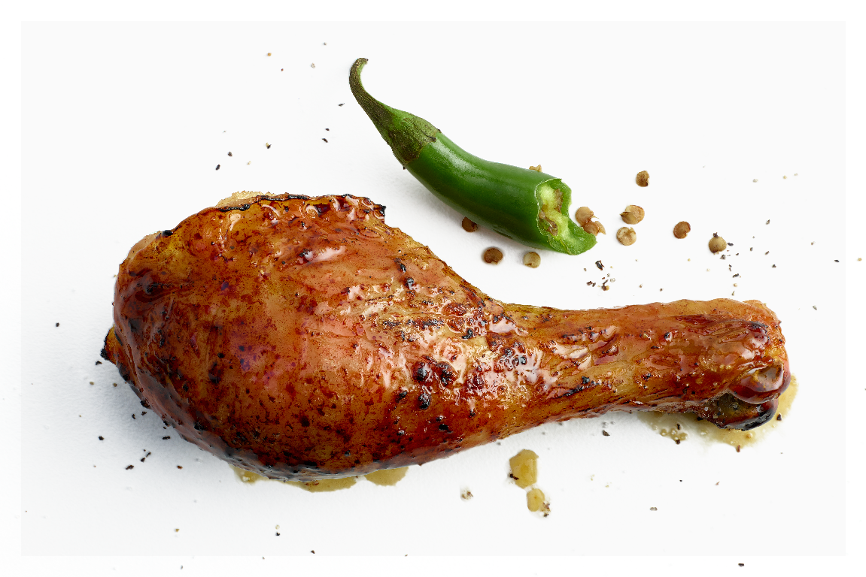
How we started

Slide 6
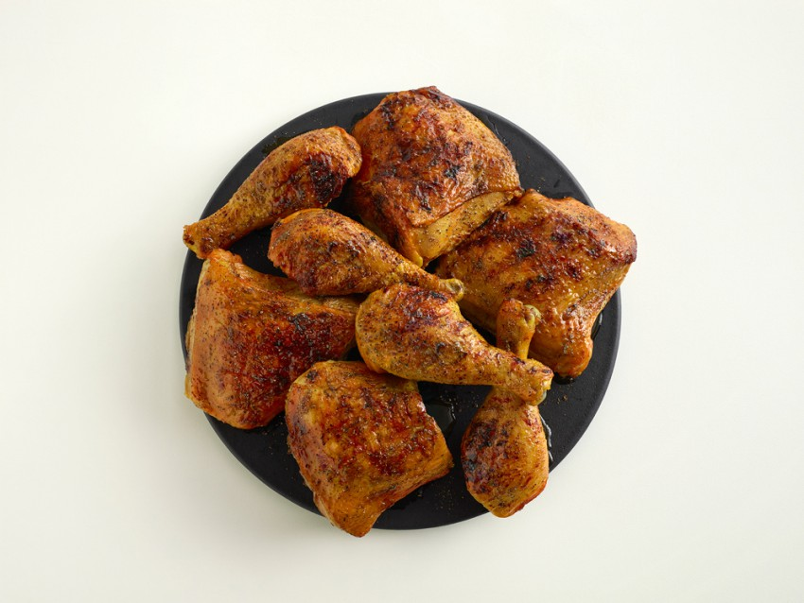
Chicken-on-the-bone
46% of what we sell

Slide 7

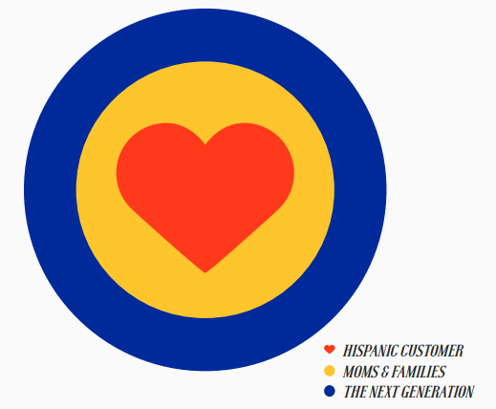
Families & Hispanics are our primary customers
51%
50%

Slide 8
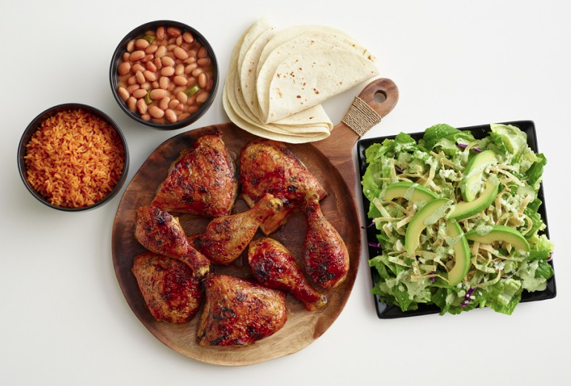
Family meals are a strength 30% of what we sell
These high-end meals carry an average check of $28

Slide 9

Families are at the heart of our advertising
Click here for video slides.

Slide 10
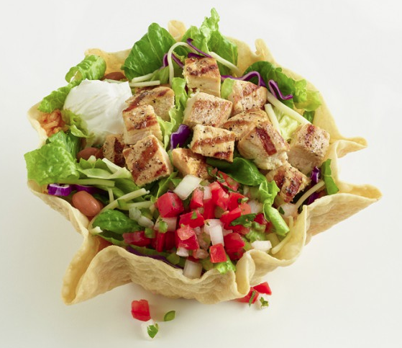
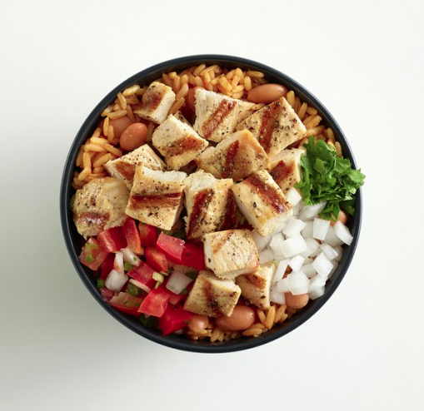
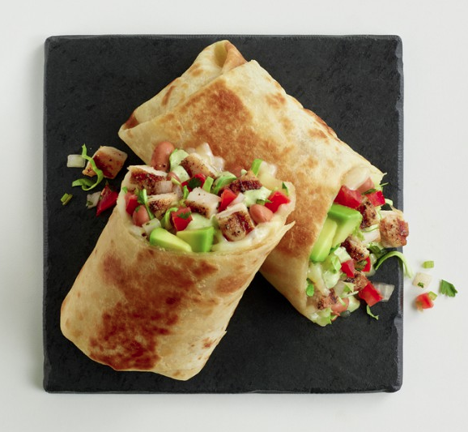
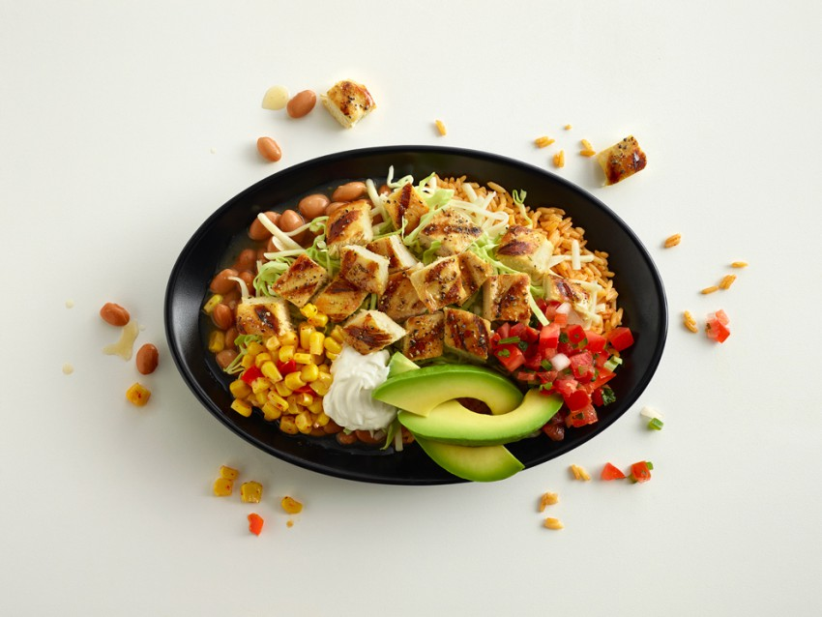
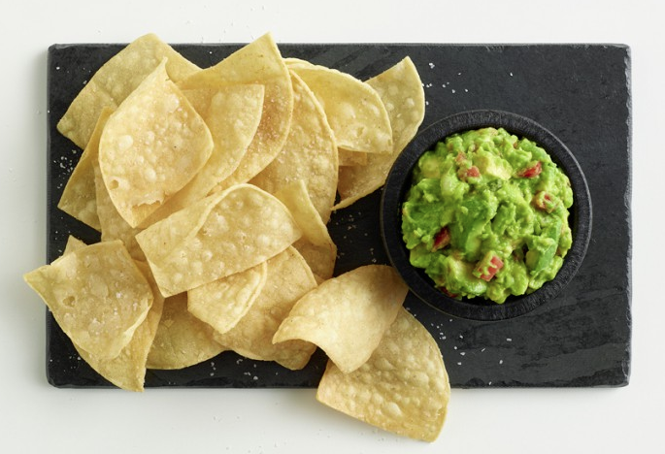
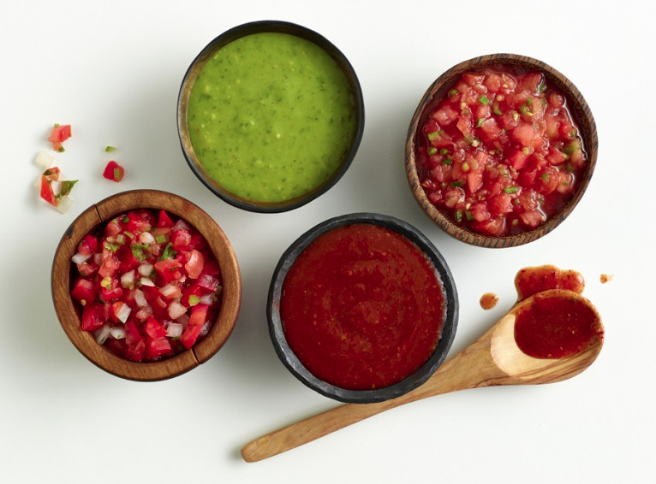
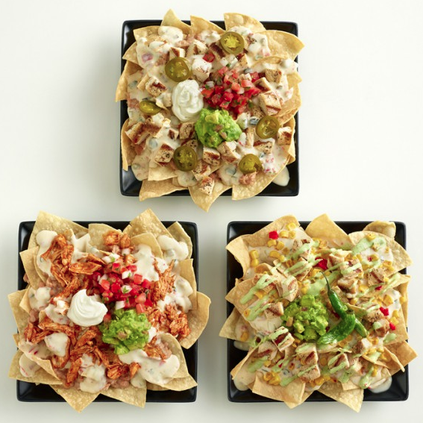
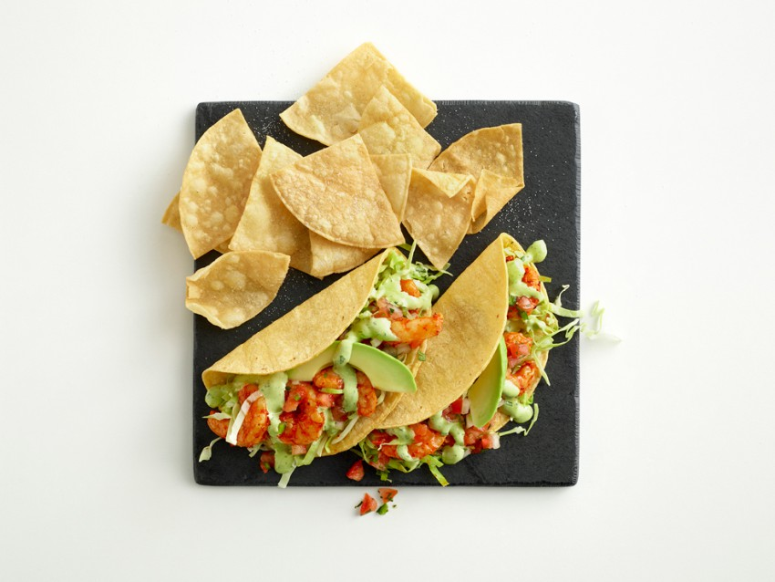
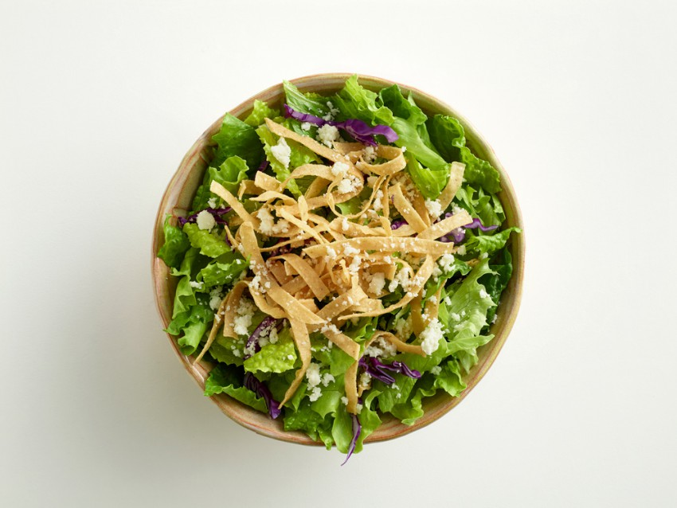
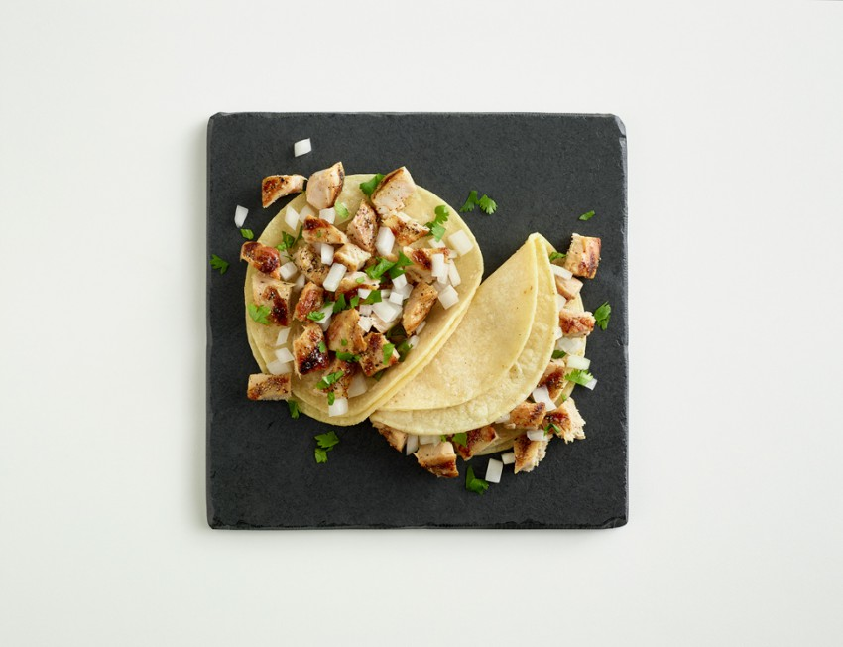
We’ve broadened beyond chicken-on-the-bone to broaden our appeal
54% of what we sell

Slide 11
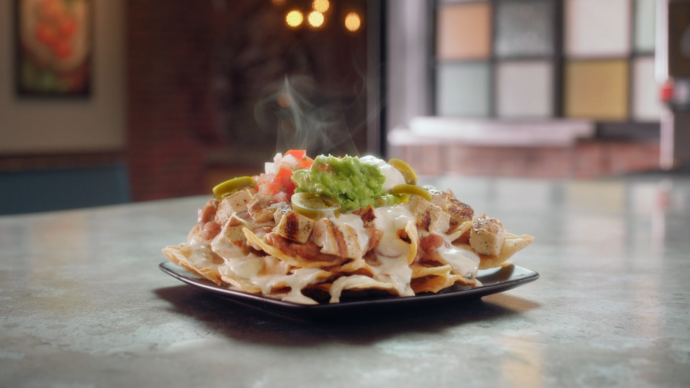
Our non-cob entrees are a break from the norm
Click here for video slides.

Slide 12
Our diversified products have enabled us to achieve industry-leading AUVs
QSR magazine 2017 top 50 (avg. unit volumes)

Slide 13
…….Which has helped fuel our growth
19% Restaurant contribution Margin
36% lunch / 24% snack / 40% dinner
1
483 restaurants in 6 states*
System wide sales $855M**
*As of Q3 2018 ended September 26, 2018
**LTM ending September 26, 2018

Slide 14
We have not lived up to our potential in the last 3 years

Slide 15
But our turnaround is underway

Slide 16
We are laying the foundation for accelerated growth in 2019 & beyond
EPL growth formula
culture
+
brand
+
execution
=
growth
People-first
Differentiated
Operations-driven
Profitable

Slide 17

Our growth formula comes to life through our transformation agenda

Slide 18




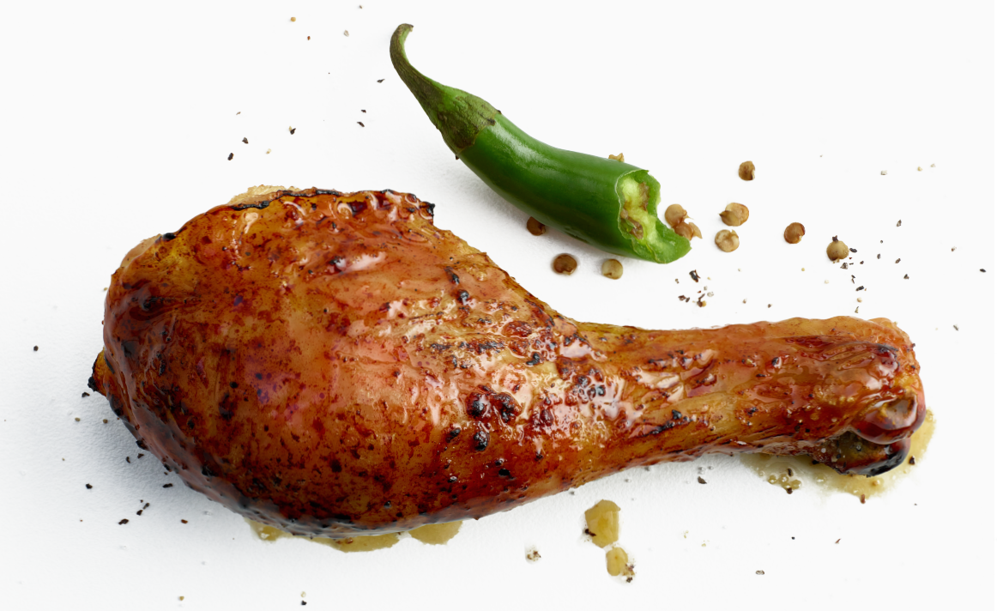




El pollo loco transformation agenda
Our strategy
Develop a people-first culture: invest in and grow our talent
Differentiate the brand: accentuate our strengths and build upon them
Simplify operations:
Make it easier to be an employee & franchisee
Grow the business: responsibly and profitably for the long-term
Our big moves
Live our
values
1
Inspire through heart-centered leadership
Build capability
2
Train for leadership and business acumen
Chicken authority
3
Become the undisputed chicken brand of choice
Better-for-you food
4
Become healthier while remaining affordable
Perfect pollo every time
5
Become fanatically obsessive over serving perfect pollo
Service that wows
6
Deliver friendly service that surprises and delights
Frictionless convenience
7
Make accessing and ordering from us effortless
Restaurant expansion
8
Achieve successful unit growth in new geographies
What we are doing about it
Bring new news to our core chicken-on-the-bone (COB)
Do a better job storytelling and getting credit for all we do BOH
HCL training
Leadership Training
Focus non-COB innovation on new recipes and platforms
Continue to invest in our products (NHA chicken, organic, etc.)
Simplify cooking procedures, retrain entire organization
Retrain entire organization on new hospitality procedures
Grow loyalty, delivery and provide access through new channels
Develop “store of the future” and grow in core and non-core markets
Workplace by Facebook

Slide 19

We are gearing up for a brand re-launch
We’ve codified our brand architecture in a brand book
Informed by an expansive customer segmentation study

Slide 20

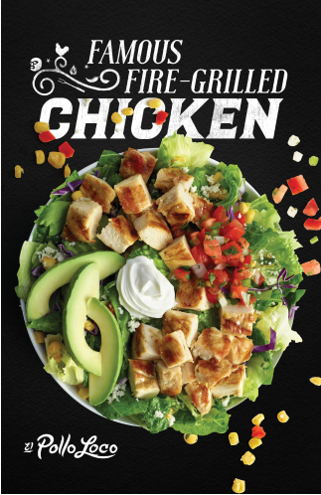

The new Brand work is a return to our roots and more visually sophisticated

Slide 21

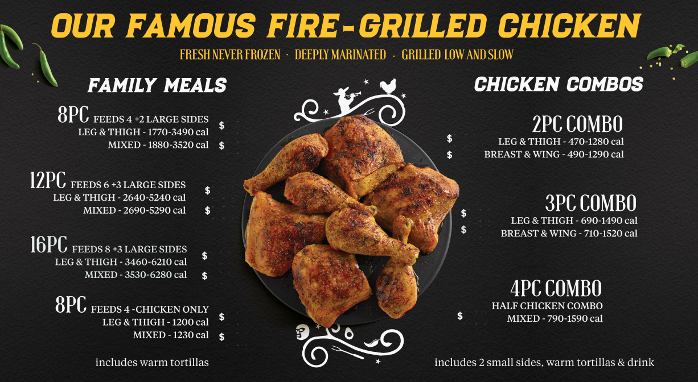
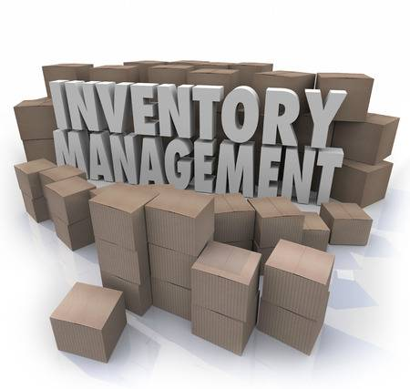
We are undergoing simplification to make the customer & Employee experience better
We are reducing the number of items on our menu by 20%
We’ve reduced the number of annual promotions from 9 to 6
We’re leveraging technology to simplify the back of house
Re-deploy the labor savings to more customer-facing initiatives

Slide 22
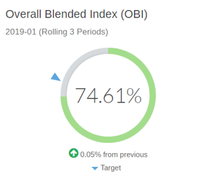
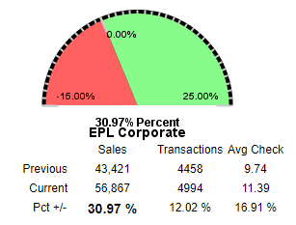
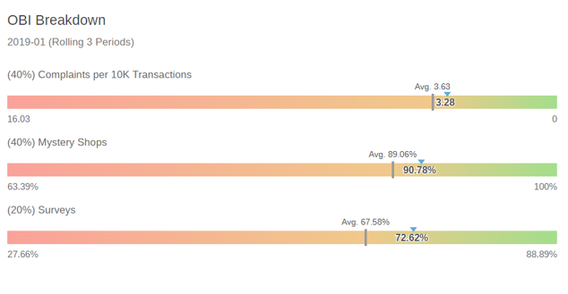
We are leveraging data to drive performance in each restaurant
This tool will further be enhanced with social media feedback in the 2nd half of 2019

Slide 23
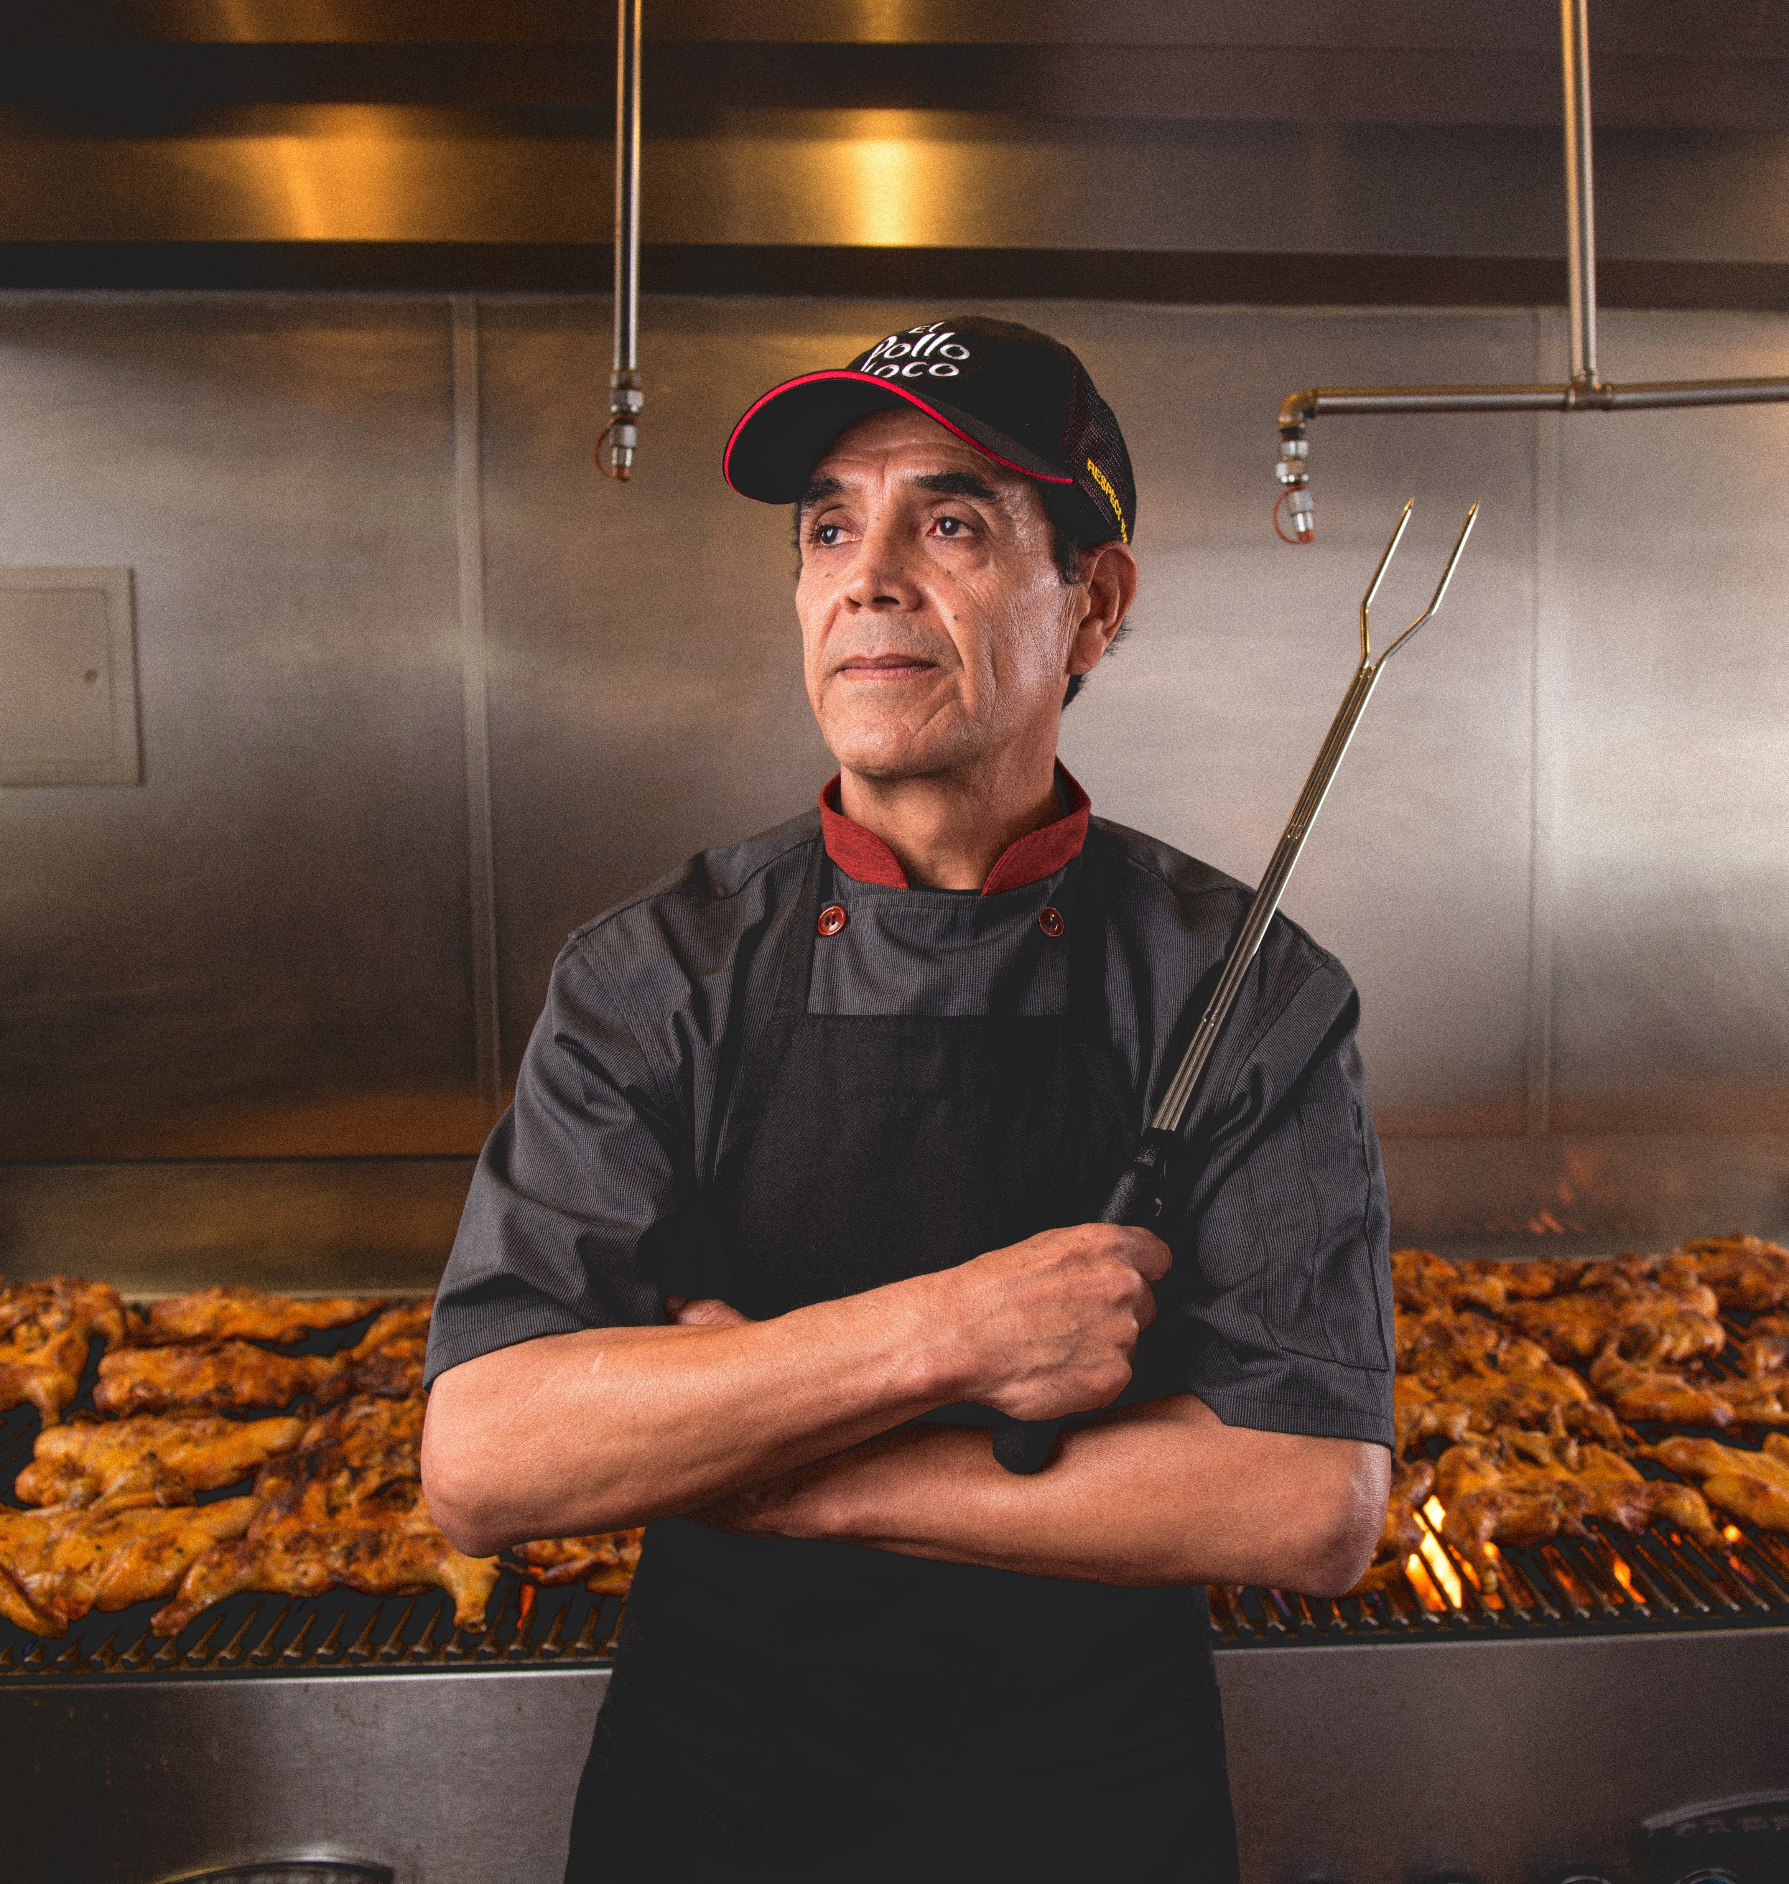
In summary…..
We are reinvigorating the brand by focusing on what we do best with clear prioritization
….and then executing with excellence by driving a culture of performance and accountability
Expect a lot more to come in 2019
We are laying the foundation for future growth in new markets
….and working hard to get back to at least 5% new unit growth in the next few years

